Slide 1
BIS Classificaion

Slide 2
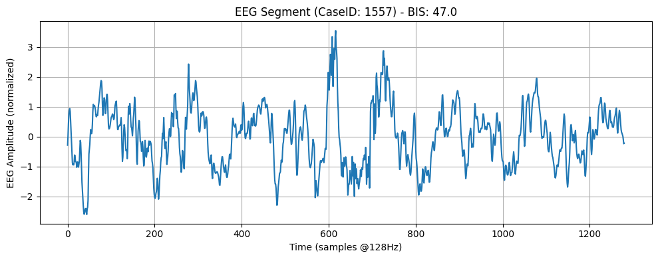
NUM_CLASSES = 4 SRATE = 128 SEGLEN = 10 * SRATE MAX_CASES = 1000 track_names = ['BIS/EEG1_WAV', 'BIS/BIS']
Setup
Dataset Summary:
Total EEG Segments: 3995864
Total Unique Patients (Case IDs): 898 File Size: 39083.08 MB

Slide 3
Attention LSTM Classifcation
Label | Precision | Recall | F1-Score | Support
0 | 0.6447 | 0.7188 | 0.6797 | 309,486
1 | 0.7702 | 0.7275 | 0.7482 | 455,588
2 | 0.6725 | 0.3430 | 0.4543 | 19,153
3 | 0.5064 | 0.1089 | 0.1792 | 1,093
Accuracy | 0.7138 | 0.7138 | 0.7138 | 0.7138
Macro Avg | 0.6485 | 0.4745 | 0.5154 | 785,320
Weighted Avg | 0.7180 | 0.7138 | 0.7133 | 785,320

Slide 4
CNN Bi LSTM Attn Classification
Label | Precision | Recall | F1-Score | Support
0 | 0.7299 | 0.7641 | 0.7466 | 309,486
1 | 0.8186 | 0.7976 | 0.8079 | 455,588
2 | 0.6362 | 0.5443 | 0.5867 | 19,153
3 | 0.5962 | 0.5700 | 0.5828 | 1,093
Accuracy | 0.7779 | 0.7779 | 0.7779 | 0.7779
Macro Avg | 0.6952 | 0.6690 | 0.6810 | 785,320
Weighted Avg | 0.7789 | 0.7779 | 0.7781 | 785,320

Slide 5
CNN Bi LSTM Classification
Label | Precision | Recall | F1-Score | Support
0 | 0.7452 | 0.7709 | 0.7578 | 309,486
1 | 0.8254 | 0.8099 | 0.8176 | 455,588
2 | 0.6379 | 0.5681 | 0.6010 | 19,153
3 | 0.5674 | 0.5508 | 0.5590 | 1,093
Accuracy | 0.7883 | 0.7883 | 0.7883 | 0.7883
Macro Avg | 0.6940 | 0.6749 | 0.6838 | 785,320
Weighted Avg | 0.7888 | 0.7883 | 0.7884 | 785,320

Slide 6
EEG_CNN Classification
Label | Precision | Recall | F1-Score | Support
0 | 0.6112 | 0.7251 | 0.6633 | 309,486
1 | 0.7572 | 0.6867 | 0.7202 | 455,588
2 | 0.7956 | 0.2023 | 0.3225 | 19,153
3 | 0.5231 | 0.0311 | 0.0587 | 1,093
Accuracy | 0.6891 | 0.6891 | 0.6891 | 0.6891
Macro Avg | 0.6718 | 0.4113 | 0.4412 | 785,320
Weighted Avg | 0.7003 | 0.6891 | 0.6872 | 785,320

Slide 7
EEG_GRU Classification
Label | Precision | Recall | F1-Score | Support
0 | 0.7701 | 0.7766 | 0.7733 | 309,486
1 | 0.8324 | 0.8320 | 0.8322 | 455,588
2 | 0.6489 | 0.5675 | 0.6054 | 19,153
3 | 0.5773 | 0.5910 | 0.5841 | 1,093
Accuracy | 0.8034 | 0.8034 | 0.8034 | 0.8034
Macro Avg | 0.7072 | 0.6918 | 0.6988 | 785,320
Weighted Avg | 0.8030 | 0.8034 | 0.8031 | 785,320

Slide 8
EEG_LSTM Classification
Label | Precision | Recall | F1-Score | Support
0 | 0.7605 | 0.7692 | 0.7648 | 309,486
1 | 0.8266 | 0.8253 | 0.8260 | 455,588
2 | 0.6461 | 0.5525 | 0.5956 | 19,153
3 | 0.5833 | 0.5608 | 0.5718 | 1,093
Accuracy | 0.7962 | 0.7962 | 0.7962 | 0.7962
Macro Avg | 0.7041 | 0.6770 | 0.6896 | 785,320
Weighted Avg | 0.7958 | 0.7962 | 0.7959 | 785,320

Slide 9
EEG Transformer Classification
Label | Precision | Recall | F1-Score | Support
0 | 0.4185 | 0.8766 | 0.5665 | 309,486
1 | 0.6582 | 0.1979 | 0.3043 | 455,588
2 | 0.0000 | 0.0000 | 0.0000 | 19,153
3 | 0.0000 | 0.0000 | 0.0000 | 1,093
Accuracy | 0.4603 | 0.4603 | 0.4603 | 0.4603
Macro Avg | 0.2692 | 0.2686 | 0.2177 | 785,320
Weighted Avg | 0.5468 | 0.4603 | 0.3998 | 785,320

Slide 10
EEG Transformer Classification
Label | Precision | Recall | F1-Score | Support
0 | 0.4185 | 0.8766 | 0.5665 | 309,486
1 | 0.6582 | 0.1979 | 0.3043 | 455,588
2 | 0.0000 | 0.0000 | 0.0000 | 19,153
3 | 0.0000 | 0.0000 | 0.0000 | 1,093
Accuracy | 0.4603 | 0.4603 | 0.4603 | 0.4603
Macro Avg | 0.2692 | 0.2686 | 0.2177 | 785,320
Weighted Avg | 0.5468 | 0.4603 | 0.3998 | 785,320

Slide 11
ResNet 1D Classification
Label | Precision | Recall | F1-Score | Support
0 | 0.6485 | 0.7443 | 0.6931 | 309,486
1 | 0.7832 | 0.7240 | 0.7524 | 455,588
2 | 0.6556 | 0.2912 | 0.4033 | 19,153
3 | 0.5879 | 0.2479 | 0.3488 | 1,093
Accuracy | 0.7208 | 0.7208 | 0.7208 | 0.7208
Macro Avg | 0.6688 | 0.5019 | 0.5494 | 785,320
Weighted Avg | 0.7267 | 0.7208 | 0.7200 | 785,320

Slide 12
SE Transformer GRU Classification
Label | Precision | Recall | F1-Score | Support
0 | 0.6481 | 0.7683 | 0.7031 | 309,486
1 | 0.7981 | 0.7110 | 0.7520 | 455,588
2 | 0.6345 | 0.3842 | 0.4786 | 19,153
3 | 0.5385 | 0.4931 | 0.5148 | 1,093
Accuracy | 0.7253 | 0.7253 | 0.7253 | 0.7253
Macro Avg | 0.6548 | 0.5892 | 0.6121 | 785,320
Weighted Avg | 0.7347 | 0.7253 | 0.7258 | 785,320

Slide 13
TCN Classification
Label | Precision | Recall | F1-Score | Support
0 | 0.5858 | 0.8393 | 0.6900 | 309,486
1 | 0.8177 | 0.5912 | 0.6863 | 455,588
2 | 0.5930 | 0.3697 | 0.4555 | 19,153
3 | 0.6102 | 0.3166 | 0.4169 | 1,093
Accuracy | 0.6832 | 0.6832 | 0.6832 | 0.6832
Macro Avg | 0.6517 | 0.5292 | 0.5622 | 785,320
Weighted Avg | 0.7206 | 0.6832 | 0.6818 | 785,320

